Slide 1
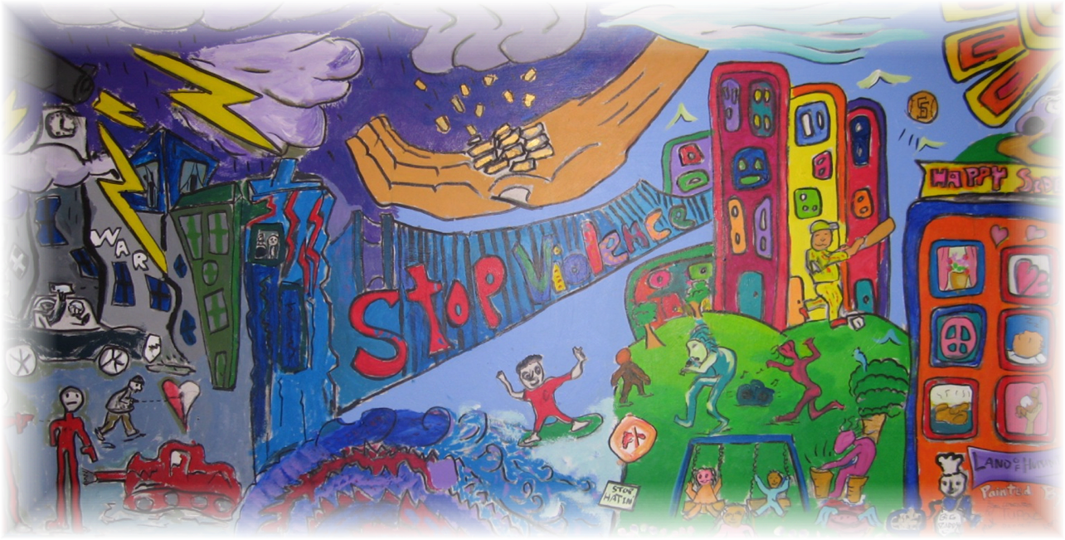
Family Violence and Protection
CIIS, 2012
Mark Purcell, PsyD

Slide 2
Course Overview
Day I
  Causes of Violence & Defining Partner Abuse
  Cycle of Violence
  Power Control & Cultural Considerations
  Activities:
    Movie: Reactions to Witnessing Domestic Violence
    Seeking Safety

Slide 3
Course Overview
Day II
  Characteristics of Abuse Victims and Perpetrators
  Trauma & Recovery Model of Treatment
  Safety Planning
  Activity: Safety Planning
  Challenges of Working with Victims/Perpetrators
  Middle Phase Working with Victims
  Skills Practice: Working with Victims

Slide 4
Course Overview
Day III
  Cultural Considerations II: Same Sex Partner Abuse
  Treatment for Perpetrators
  Different Approaches to Domestic Violence Treatment
  Behavioral Interventions and Couples Therapy
  Activity: Working with Perpetrators
  Movie: Ending the Cycle of Violence
  Self Care and Closing

Slide 5
Theories of Aggression
Instinctual Theory
  Interaction of biological basis and environment
Frustration Theory
  Aggression caused by being blocked from perceived goal - Societal/Environment factors
Social Learning Theory
  Modeling
Patriarchial Theory - Feminist Theory
  Structural/Institutionalized Power

Slide 6
General Model of Aggression
Social
Inhibition/Disinhibition
Environmental Impact
RESPONSE
EMOTION
Aggression
Other Responses
Anger
Frustration/ Instigation
Type
Intention
Person
Self-Deprecation
Displacement
Denial
Withdrawal
Socio-cultural
Factors
Redefine Meaning/Motives

Slide 7
Prejudice/Privilege/Oppression and Domestic Violence
Prejudice - a negative judgement, assumption or
belief about an individual based on race, class, gender,
ethnicity, homelessness, age, disability, obesity, religion,
sexual orientation, or other personal characteristics.
Privilege - to benefit from or hold preferred status in
society based on race, class, gender, ethnicity, age, ability,
religion, sexual orientation, or other personal
characteristics.
Oppression - the use of authority, law or physical force to
deny equal access to resources, opportunity, and
economic equity.

Slide 8
Intergenerational Trauma
Historical/Intergenerational trauma (HT) is cumulative emotional and psychological wounding, over the lifespan and across generations, emanating from massive group trauma experiences. The historical trauma response (HTR) is a constellation of features in reaction to this trauma.
The HTR may include substance abuse as a vehicle for attempting to numb the pain associated with trauma. The HTR often includes other types of self-destructive behavior, suicidal thoughts and gestures, depression, anxiety, low self-esteem, anger, and difficulty recognizing and expressing emotions. Associated with HTR is historical unresolved grief that accompanies the trauma.^{[1]}
Historical trauma is an example of transgenerational trauma.

Slide 9
Causes of Youth (and Adult) Urban Violence
Socio-economic inequality
For too many African American [and other minority] youth, being cut off from the paths to legitimate and self-determined personal accomplishment as a result of the underdeveloped power of the African American community, the violent subduing of others may often be their only significant achievement and ‘claim to fame.’ Their capacity to perpetuate violence is the great equalizer in a world characterized by great inequalities¹.
¹Wilson, A. (1990). Black-on-black violence. Info Systems: Afrikaan World.

Slide 10
Power and Control Wheel
Asian Women’s Shelter, adapted from the Domestic Abuse Intervention Project in Duluth, Minnesota (ver. 6/6/97)

Slide 12
What Is Trauma?
Definition in DSM-IV:
Traumatic events “outside the range of usual human experience”
However, many experiences are more common than they should be:
  Domestic violence, community violence, abuse, sexual abuse

Slide 13
What Is Trauma?
Traumatic Events are extraordinary, not because they occur rarely, but because they overwhelm the ordinary human adaptations to life.
Generally involve threats to life or bodily integrity, or a close personal encounter with violence and death.
Involve extremities of helplessness and terror.
Response of intense fear, helplessness, loss of control, and threat of annihilation.

Slide 14
Who is at Risk and What is Traumatic?
Trauma can come from a variety of sources and affect many different people:
  Socio-cultural & environmental factors
    Community Violence, War, Immigration
    Intergenerational Trauma
  Close interactions
    Physical/Sexual Abuse, Assault, Domestic Violence
  Disasters
    Natural Disasters, Accidents, Etc.

Slide 15

Trauma Affects All Aspects of the Self
Cognitive
Emotional
Social
Cultural
Physical / Somatic
Spiritual

Slide 16
Adaptive Responses to Trauma
Physiological
Hyperarousal
Agitation
Hopelessness
Amnesia
Insomnia
Intrusive Memories
Traumatic
Event
Nightmares
Hypervigilance
Shame & Self Hatred
Decreased
Interest
Somatic Symptoms
Chronic Pain
Numbing
Dissociative
Symptoms
Irritability
Depression
Self Destructive
Behavior
Generalized Anxiety
Panic Attacks
Substance Abuse
Eating Disorders
Fisher, 2005
Notes:
The Use of Adaptive Coping Strategies: When you look at this list what do you see? Probably a lot of problematic behaviors and diagnoses.
Audience Engagement Exercise:
Think of your more complex clients and their symptoms. Write down what you think might be the adaptive intent for each of their symptoms.
What is the adaptive intent of :
Self Destructive Behavior such as cutting? (protection from more vulnerable feelings)
Substance use : (numbing, distraction from memories)
Eating Disorders
Under eating (maintain a sense of control)
Over eating (compensate for feelings of unworthiness, mask anxiety)
Hypervigilance: ensure safety a all times
Hopelessness: Avoidance of success/failure
Each one of these is a trauma-related symptom, an adaptive trauma response or survival resource that has become a coping strategy that may have been effective at some time, but later interferes with the person's ability to live the life s/he wants. Survivors of repetitive early trauma are likely to instinctively continue to use the same self-protective coping strategies that they employed to shield themselves from psychic harm at the time of the traumatic experience.
Hypervigilance, dissociation, avoidance and numbing are examples of coping strategies.
It is useful to think of all trauma "symptoms" as adaptations. Symptoms represent the client's attempt to cope the best way they can with overwhelming feelings.
When we see "symptoms" in a trauma survivor, it is always significant to ask ourselves: what purpose does this behavior serve? Every symptom helped a survivor cope at some point in the past and is still in the present -- in some way. We humans are incredibly adaptive creatures. Often, if we help the survivor explore how behaviors are an adaptation, we can help them learn to substitute a less problematic behavior.
By the time the trauma survivor appears at our doorstep, the neurobiological and psychological effects of a hyperactivated autonomic nervous system and disorganized attachment patterns will have become well-entrenched, familiar, habitual responses. These symptoms now subjectively feel like “just who I am.” In the words of one client, “it was bad enough that I was abused and neglected by my family and had to spend the next twenty years trying to survive what happened, but why did it have to affect who I am?” The symptoms that come to seem “just who I am” are the conveyors of the history that cannot be fully remembered or put into words.
In addition, other symptoms develop that represent valiant neurobiological attempts to cope with the trauma: self-injury and suicidality, risk-taking, re-enactment behavior, caretaking and self-sacrifice, re-victimization, and addictive behavior. All of these represent different ways of modulating a dysregulated nervous system: self-injury and planning suicide both induce adrenaline and endorphin responses; self-starvation and overeating each induce numbing; and addictive behaviors can be tailored to induce either numbing or increased arousal or a combination of both.

Slide 17
Connecting the dots…..
From early childhood experiences to
Vulnerability to pathological
authoritarian control

Slide 18
Trauma-Related Symptom Clusters
Hyper-Arousal
Hypervigillance
Constant threat – Fight/Flight
Intrusion
Flashbacks
Constriction
Avoidance of reminders
Numbing of Feelings
Always on Alert
Re-experiencing
Re-living Event as if happening now
Freeze Response
TRAUMATIC EVENT

Slide 19
PTSD Symptoms:
Intrusion & Re-experiencing Trauma
Intrusive, upsetting memories of the event
Flashbacks (acting or feeling like the event is happening again)
Nightmares (either of the event or of other frightening things)
Feelings of intense distress when reminded of the trauma
Intense physical reactions to reminders of the event (e.g. pounding heart, rapid breathing, nausea, muscle tension, sweating)

Slide 20
PTSD symptoms:
Avoidance and Emotional Numbing
Avoiding activities, places, thoughts, or feelings that remind you of the trauma
Inability to remember important aspects of the trauma
Loss of interest in activities and life in general
Feeling detached from others and emotionally numb
Sense of a limited future (you don’t expect to live a normal life span, get married, have a career)

Slide 21
PTSD symptoms:
Increased arousal
Difficulty falling or staying asleep
Irritability or outbursts of anger
Difficulty concentrating
Hypervigilance (on constant “red alert”)
Feeling jumpy and easily startled

Slide 22
The Dialectic of Trauma
Sufferers are caught between two extremes:
  Amnesia and numbing from all feeling to avoid the related emotions and thoughts
  Constant re-living of the trauma and constant guard against it

Slide 23
Complex Trauma
Complex post-traumatic stress disorder (C-PTSD) is
Caused by chronic, protracted exposure to prolonged social and/or interpersonal trauma in the context of either captivity or entrapment
Examples: Captivity, Domestic Abuse, Child Physical Sexual Abuse
Results in the lack or loss of control, helplessness, and deformations of identity and sense of self.

Slide 24
Complex Trauma
Systems of Meaning
Despair Hopelessness
Personality & Relationships
Perception of Self Other
Affect
Dysregulation
Modulating Anger
Arousal (PTSD)
Cognitive
Dissociation
Victim-Perpetrator
Substance Abuse
Self-Harm
Concentration
Numbing
Avoidance (PTSD)
Re-Victimization
Trust
Loss of Values
World Unsafe
Future (-)

Slide 25
Complex Trauma Symptoms
Alterations in regulating affective arousal
(1) chronic affect dysregulation
(2) difficulty modulating anger
(3) self-destructive and suicidal behavior
(4) difficulty modulating sexual involvement
(5) impulsive and risk-taking behaviors

Slide 26
Complex Trauma Symptoms
Alterations in attention and concentration
(1) amnesia
(2) dissociation
Somatization

Slide 27
Complex Trauma Symptoms
Chronic chacterological changes
(1) alterations in self-perception: chronic guilt and shame; feelings of self-blame, of ineffectiveness, and of being permanently damaged
(2) alterations in perception of perpetrator: adopting distorted beliefs and idealizing the perpetrator
(3) alterations in perceptions of others:
(a) an inability to trust or maintain relationships with others
(b) tendency to be re-victimized
(c) a tendency to victimize others

Slide 28
Complex Trauma Symptoms
Alterations in systems of meaning
(1) despair and hopelessness
(2) loss of previously self-sustaining beliefs

Slide 29
Self-Perpetuating Cycle
Initial Trauma
PTSD Symptoms
Heightens Trauma Symptoms
Substance Abuse – Leads to Increase Abuse/Trauma
Re-traumatization

Slide 30
Trauma, Disorganized Attachment & Violence
Experiences in infancy which result in the child’s inability to regulate strong emotions are often the overlooked source of violence in children and adults
  From Ghosts From the Nursery

Slide 31
Trauma, Disorganized Attachment & Violence
Early childhood maltreatment impacts:
  Attachment
  Brain Development – Right Brain, limbic system and emotional regulation
  Fight/Flight Response
Disorganized insecure attachment pattern

Slide 32
Trauma, Disorganized Attachment & Violence
Disorganized Attachment: biological vulnerability & environmental stressors
Leads to affective dysregulation/aggression
Bio-social pattern for violence consistent from infancy, childhood, adolescent, adult
Personality Disorders: Borderline/Antisocial

Slide 33
Trauma, Disorganized Attachment & Violence
Early childhood maltreatment impacts:
  Attachment
  Brain Development – Right Brain, limbic system and emotional regulation
  Fight/Flight Response
Disorganized insecure attachment pattern

Slide 34
Trauma, Disorganized Attachment & Violence
Most traumatized or neglected children do not turn into abusers or violent criminals.
Usually, they have some positive relationship – resiliency & secure attachment
Others experience complex trauma and highly conflicted relationships

Slide 35
Treatment Implications
Primary Goals:
  Establish Safety
  Help person re-connect and attach to others
Merely uncovering memories is not enough; they need to be modified and transformed.
The trauma needs to become a part of the person’s past (like other events) rather than re-lived in the present.

Slide 36
Treatment Implications
Exploring the trauma for its own sake has no therapeutic benefit unless it becomes attached to other experiences, such as feeling understood, being safe, feeling strong and capable, or being able to empathize with others.
Finding some kind of personal meaning of the trauma

