Slide 1
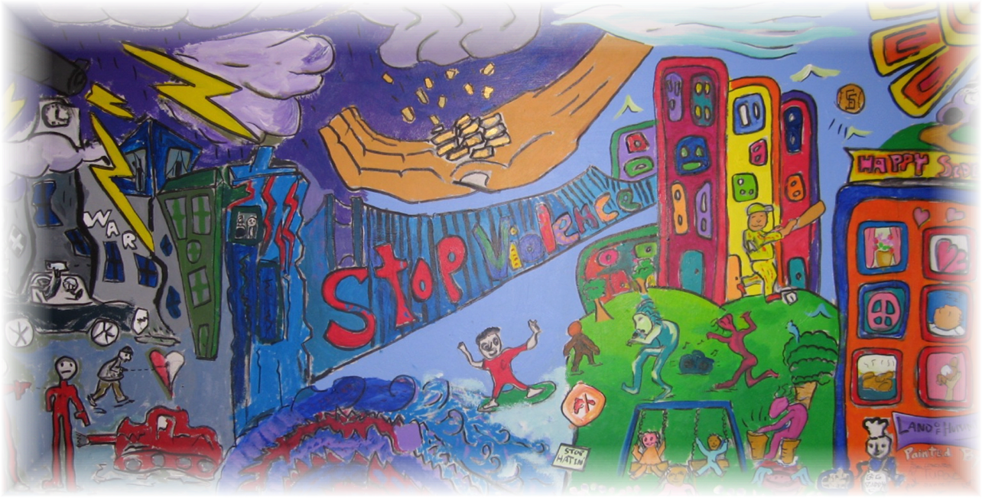
Family Violence: Week II
Presented by Mark Purcell, PsyD

Slide 3
Cycle of Violence
Phase I: Tension Building
(can last several days to months)
Minor battering incidents, escalation
Phase II: Battering
Actual explosion, acute battering
Phase III: Honeymoon
Playful, loving, kind, promises, courtship, absence of abuse

Slide 4
Power and Control Wheel
Asian Women’s Shelter, adapted from the Domestic Abuse Intervention Project in Duluth, Minnesota (ver. 6/6/97)

Slide 5
Partner Abuse Theories
Sociopolitical Feminist Theory
Patriarchal
Power and Control
Gender Role Rigidity
Psychological Theory
Personality and Behavioral Characteristics
Individually Based
Integration of Social-Psychological

Slide 6
Prejudice/Privilege/Oppression and Domestic Violence Small Group Activity
A Woman
A Person of Color
An Immigrant
An Undocumented Immigrant
A Person Who Doesn’t Speak English
A Lesbian/Gay/Bi-Sexual Person
A Person with Disabilities
A Poor Person
A Transgender Person
An Elderly Person or A Young Person

Slide 7
Questions
How does being ________________
… become used as part of the abuse?
… prevent you from knowing where to get help?
… make survival difficult or impossible if you leave the one abusing you?
… subject you to more abuse by those who are supposed to help?

Slide 8
Why She/He Stays… Or Returns
Fear and Terror
Low Self Esteem
Economic Dependence
Lack of Legal Sanctions
Keeping the Family Together
Guilt
Promises of Change
Emotional Dependence
Fear of Insanity
Isolation
Lack of Support
No Place to Go
Learned Behavior
Fear of Deportation
Fear of Being “Out-ed”
Spiritual/Religious Beliefs
Hopeless, “no way out”

Slide 9
Victim Response to Abuse
Depression/Suicidal thoughts
Psychosomatic complaints (back hurts, sleep problems, feels terrible overall, exhaustion, headaches, gastrointestinal issues, loss of appetite)
Social Isolation
Lack of sense of self/identity
Emotional and Economic Dependence
PTSD
Self –Blame/Excuses for perpetrator
Low Self-Esteem

Slide 10
DV Victim Responses: Role Induction Theory
Appeal to Salvation Ethic
Victim places own happiness and safety below husband
Must save husband, marriage, before self
Denial of the Victimizer
Externalize reason for abuse
Job loss, stress, acting-out children, etc.

Slide 11
DV Victim Responses: Role Induction Theory
Denial of Injury
Minimize/denial of incident by victim
Denial of Victimization
Victim blames self
Denial of Options
Victim believes no options
Appeal to Higher Loyalties
Traditional values/religion

Slide 12
Other DV Victim Responses
Learned Helplessness
Feels Hopeless + no action = Helplessness
Stockholm Syndrome
Common Characteristics:
Victims perceived more positive than negative
Did not see change in severity
Did not perceive relationship “as bad as it could be”

Slide 13
Teen Dating Violence
What is Dating violence?
Definition: Dating Violence is a pattern of assaultive and controlling behavior that one person uses against another in order to gain/ maintain power and control in the relationship.
The abuser intentionally behaves in ways that cause fear, degradation and humiliation to control the other person. Forms of abuse can be physical, sexual, emotional and psychological.

Slide 14
Teen Dating Violence
Stalking
Definition: A willful course of conduct involving repeated or continued harassment or another individual that causes a reasonable person to feel terrorized, frightened, intimidated, threatened
Forms: Following, approaching, confronting in public or private place, repeated telephone calls, repeat mail/email, using surveillance, cyberstalking (using internet to track, slander, harrass)

Slide 15
Seeking Safety – Experiential Exercise#1
“No feeling is final.”
-Rainer Maria Rilke
(20th-century German poet)
Grounding technique to detach from Emotional Pain

Slide 16
Healing Trauma: Stages of Recovery
Healing Relationship
Establish Safety
Remembrance and Mourning
Reconnection
Commonality

Slide 17
Stages of Recovery: Healing Relationship
Be aware of Power Dynamic in therapeutic relationship
Traumatic Transference:
Pleasing therapist, fear, safety, trust
Traumatic Counter Transference
Rescuing, vicarious traumatizaton, rationalizing
Observe boundaries, remain non-judgemental, reflective

Slide 18
Establish Safety
Intervention with Victims: Safety Planning
If Client/Victim Is Planning to Leave:
Do they have a friend who they can stay with?
Do they want to go to a shelter?
Police, order of protection

Slide 19
Safety Planning/Crisis Intervention
Create a Safety Plan
If in immediate danger, call 911
Shelter/Safe House Referral
Legal/Protection Referral
Medical referral

Slide 20
Safety Planning/Crisis Intervention
Personalized Safety Plan
-In the relationship
Identify support (people and places to stay)
Make check-list (see next page)
Open own savings account
Rehearse my escape route with a support person

Slide 21
Safety Planning/Crisis Intervention
Personalized Safety Plan
-In the relationship
Checklist (Items to Take):
Identification, Drivers License, Birth certificates for me/kids, Social Security Cards
Welfare Id, Passport/green card, work permit
School/Medical Records,
Money, bank book, credit cards, bills
Keys- house/car/office
Medications
Change of clothes
Divorce papers
Insurance papers
Pictures, jewerly, sentimental items
Children’s favorite toys/blankets

Slide 22
Safety Planning/Crisis Intervention
When relationship is over
Inform people who take care of my children of names of those who have permission to pick them up
Tell _____ at work about my situation and ask them to screen my calls
I can change locks, install security system
I can avoid places/stores I went when living with my battering partner
I can obtain a restraining order
If I might return to abusive situation, I can call __________ for support
I can attend support groups, counseling

Slide 23
Mandated Reporting/Ethical Considerations
Not required to report partner abuse/domestic violence unless abused is a child, dependent adult or elder
Child simply witnessing domestic violence in and of itself is not reportable, only if child exhibits distress

Slide 24
Mandated Reporting/Ethical Considerations
Tarasoff (1974)
Duty to warn if your client makes a serious threat of violence to a reasonably identifiable victim/s.
Must warn intended victim and police

Slide 25
Seeking Safety
Skills Focus vs. Processing Trauma
Present Focus
Safety
Grounding
Asking for Help

Slide 26
Seeking Safety
Treatment Format
Topics conducted in any order
Treatment can be individual or group
For patients with PTSD and/or Substance Abuse
Treatment Process
Encourage methods that work

Slide 27
Seeking Safety
Treatment Principals
Use empathy to de-escalate
Praise accountability and commitment
Give Patients Control
Redirect and focus to manage time
Validate criticisms (of self and group)
In group protect clients from triggering each other

Slide 28
Middle Phase of Treatment for Victims
Meeting Them Where They Are and Supporting Change

Slide 29
Motivational Interviewing
Match Intervention with Stage of Change
Express Empathy
Develop Discrepancy
Roll with Resistance
Support Self-Efficacy

Slide 30
Motivational Interviewing (MI) Themes with Adolescents/TAY
Collaboration
Forming a partnership with the youth/young adult
Evocation
Eliciting reasons for change, rather than lecturing, or advising
An active-process that takes MI beyond client-centered apporaches to more goal directed interventions.

Slide 31
MI Skills: Empathy
Express Empathy
Very important for adolescents and young adults because it is a period when youth may not feel acceptance and understanding from adults
Feeling accepted and understood is very critical to adolescents as the struggle with forming their identity, coping with challenges
Empathy can help with developing intrinsic motivation

Slide 32
MI Skills: Develop Discrepancy
Promoting behavior change by evoking, reflecting, magnifying discrepancy between youth values and goals, and current behaviors.
Behavior change as a result of external forces may be less consistent or long lasting
Involves practicing behaviors consistent with personal values.

Slide 33
MI Skills: Support Self-Efficacy
Behavior change occurs when the behavior is deemed important and…
…when s/he feels capable to make the change.
Important for therapist to take a genuine stance of hopefulness and belief in the youth’s capacity to make changes.

Slide 34
MI Skills: Roll with Resistance
Resistance as an interpersonal process
Different signs of resistance a youth may show
Change subject, anger, defiance
Sustain versus change talk
Therapist Responses:
Stop – pause and observe what is happening
Drop – drop current approach and try something different
Roll – do not continue to argue for change. Express understanding/empathy for youth’s point of view, emphasizing personal choice

Slide 35
Solution Focused
By helping people identify the things that they wish to have changed in their life and attending to those things that they wish to continue to have happen, therapists help their clients to construct a concrete vision of a preferred future for themselves.
Techniques
Miracle Questions
Scaling Questions
Exception Seeking Questions
Coping Questions

Slide 36
Effects of Abuse on Victim
Economic Impact
Physical Impact
Psychological
Fear of Closeness/Trust
Low Self-Esteem
Impact on Sexuality
Depression & Anxiety

Slide 37
Clinical Practice
Working with Victims

Slide 38
Same Sex Domestic Violence /Partner Abuse
What is Same Sex Domestic Violence?
Definition: a pattern of abuse in an intimate relationship that is perpetrated by one person against his/her partner for the purpose of establishing control.

Slide 39
Same Sex Domestic Violence /Partner Abuse
What is Homophobia?
Irrational fear, aversion to and hatred of homosexuality.
What is Heterosexism?
The assumption that all people are innately heterosexual
and that heterosexuality is superior/more desirable than
homosexuality or bisexuality.
What is the connection between Homophobia and Violence against Women?
How does Patriarchy and/or rigid gender roles contribute to domestic violence? How does it contribute to same sex domestic violence?

Slide 40
Same Sex Domestic Violence /Partner Abuse
Myths about Lesbian Battering
See attached sheet
Facts about Gay Battering
Legal Protection/law enforcement may be unreliable
Claiming “mutual abuse” to friends, law enforcement, service providers
Prevent victim from practicing safe sex
Blame victim for arguments or anything that goes wrong in relationship, including battering
Threatens to “out” victim to work, family, friends
Rigid sex roles/forced/coerced or becomes angry when sexual demands are not met
Pressures victim to use drugs/alcohol
Normalizing the abuse in gay relationships (esp when victim is less experienced)

Slide 41
Working With Agressors
Efficacy of Treatment Models
Power-Sontrol Approach
Solution Focused
Narrative
DBT/Emotional Regulation

Slide 42
Efficacy of Treatment Models
Rates of recidivism in most perpetrator- and partner-focused treatments are approximately 30% within 6 months, regardless of intervention strategy used.
Couples treatment approaches that simultaneously address problems with substance abuse and aggression yield the lowest recidivism rates
Manualized child trauma treatments are effective in reducing child symptoms secondary to IPV.

Slide 43
Interventions with Perpetrators: Feminist/Social Learning
Violence is learned behavior that is reinforced
Focus on perpetrator
Learn new behaviors for coping, expressing, communicating

Slide 44
Interventions with Perpetrators: Feminist/Social Learning
Deluth Model – Power and Contro
Violence is learned behavior that is reinforced
Focus on perpetrator
Learn new behaviors for coping, expressing, communicating

Slide 45
Interventions with Perpetrators
Cognitive Behavioral
Behavior Management, Cognitive Distortions, Schema
Healthier Social Learning - Groups
Solution Focused Approaches
Scaling
Coping
Narrative Approach
Externalize problem
Develop new narrative for self
Psychodynamic Approach
Understand childhood dynamics and current relational patterns

Slide 46
Interventions with Perpetrators
Behavioral/Anger Management Strategies
(ART) – Aggression Replacement Training
Social Skills
Assertive vs. Aggressive
Anger Control Strategies
Triggers, Anger Reducers, Awareness
Moral Reasoning

Slide 47
Intervention with Couples: DBT Perspective
Emotional Vulnerability
Heightened Negative Emotional Arousal
Judgments Inaccurate Expression
Misunderstanding and Conflict

Slide 48
DBT with Couples: Conflict Patterns
Constructive Engagement Pattern
Mutual Avoidance Pattern
Destructive Engagement Pattern
Engage-Distance Pattern

Slide 49
DBT: Stop Making things Worse
Commitment to Change
Self-Righteous is not “Right”
Stepping out is not Surrender
Anticipate Impulsiveness
Rehearse new emotional response
Manage Destructive Urges
Visualize negative consequences of urge
Step Out and Observe Urge
Visualize (+) consequences of effective response

Slide 50
Seeking Safety: Experiential Activity
Coping tools
Commitments
Compassion

